Slide 1
PROJECT OVERVIEW & TOOLKIT INTRODUCTION
Notes:
How to use this presentation package
This presentation and speaking notes provide an overview of Reconsidering Museums from the initial research findings to the final toolkit. Links to the relevant reports and tools are embedded directly in the presentation for ease of access. Use this presentation package to share the project findings and toolkit with your colleagues, Board members, community members, funders, government representatives, or other stakeholders.
The full presentation will take approximately 30-45 minutes to present. For a shorter presentation, use slides 1-16 and 26-39. To shorten it further, omit slides 32, 33, 35, and 36.

Slide 2
We acknowledge that our work takes place on the territories of the many First Nations, Métis, and Inuit who have lived on and stewarded the land now known as Canada and its stories since time immemorial. We acknowledge the colonial legacy of museums and the harm caused by our sector and commit to respecting and promoting Indigenous peoples’ right to self-determination. We seek to collect the many perspectives that contribute to our shared history, present, and future as we work towards reconciliation.
Notes:
Reconsidering Museums is a national project that takes place on the territories of many Indigenous peoples.

Slide 3
What do Canadians see as the value of museums for them, their communities, and for Canada?
Reconsidering Museums, a three-year national project, sets out to answer the question, what do museums mean to Canadians? Through a rearticulation of the value of museums and a rebrand of the sector, this project aims to support museums with the tools and language necessary to better connect with and serve their communities, deepening their relationship, and therefore their relevance, to the Canadian public.
Notes:
Reconsidering Museums is a research and advocacy project that provides relevant contemporary data on the social value of museums, messaging to communicate and affirm that value, and resources to support museums in responding to changing public perceptions and expectations of museums.

Slide 4
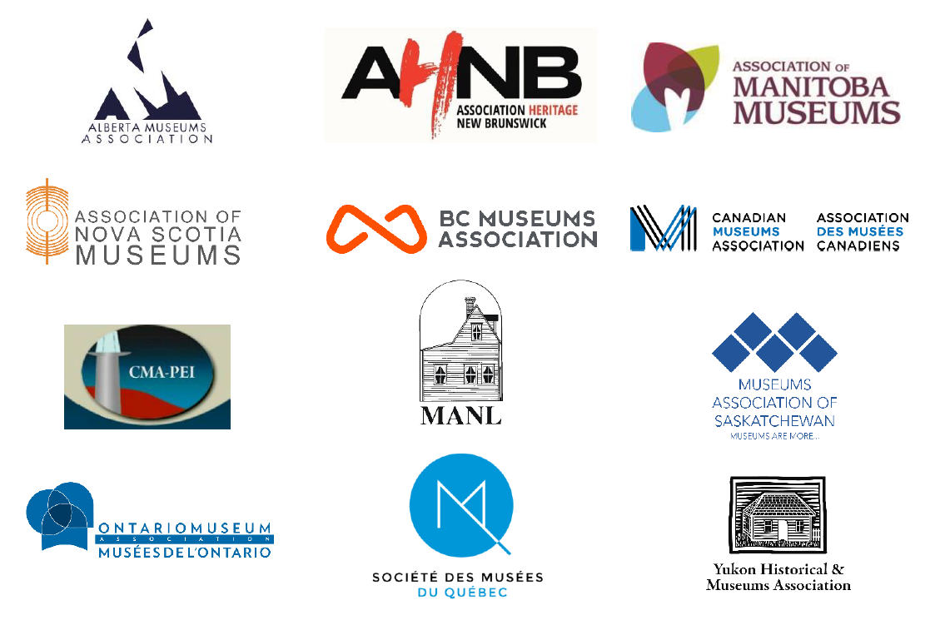
Notes:
Launched in 2020, Reconsidering Museums was undertaken in partnership with a consortium of provincial and territorial museums associations and the Canadian Museums Association, led by the Alberta Museums Association.

Slide 5
Notes:
The first phase of the project was to listen to Canadians and to collect data on their views on the role, value, and future of museums. Museums for Me was an online engagement campaign that included a series of consultations undertaken by Hill+Knowlton Strategies Canada on behalf of the consortium.

Slide 6
METHODOLOGY
1759
online survey respondents
87
dialogue session participants
1400
public opinion research respondents
500,000+
over half a million Canadians reached
Notes:
​From October 2020 to March 2021, an online survey was fielded in both French and English at museespourmoi.ca and museumsforme.ca. The survey collected 1759 responses. Due to the nature of distribution and promotion through the provincial and territorial museums associations, respondents were more likely to be avid museum goers than the general public.
To counter this bias, the consortium also conducted public opinion research through Leger Opinion’s online panel collecting 1400 responses over the period March 12-17, 2021. The sample was randomly selected based on quotas to reflect census data for age, gender, and regions in Canada. Respondents who identify as Indigenous and those with a household income below $40,000 a year were oversampled by an extra 200 cases each to ensure representation from those groups. The data was weighted to ensure representativeness by age, gender, and region.
The consortium also hosted dialogue sessions in November and December 2020, three in English and one in French. Participants had to register to take part and there were 87 participants. An additional online meeting was hosted with the Fellows of the Canadian Museums Association with seven fellows participating.
This engagement campaign was central to Reconsidering Museums and the data collected informed the creation of the subsequent messaging and toolkit. To learn more about this research and the findings, please read the What We Heard report, which is available as part of the toolkit.

Slide 7
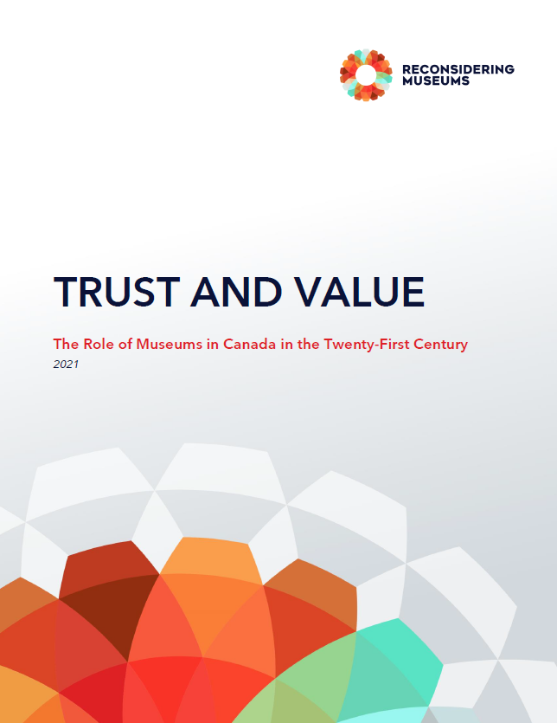
CHANGES in PUBLIC PERCEPTION
What has stayed the same?
What has changed?
What will change?
Notes:
Reconsidering Museums is the first time since 1973 that a national study gathered data on the Canadian public’s perceptions and attitudes towards museums. The 1973 study titled, The Museum and the Canadian Public by Brian Dixon, Alice Courtney, and Robert Bailey, was conducted in conjunction Canada’s first National Museum Policy, released the previous year.
To understand changes in public perception between Museums For Me in 2021 and the 1973 study, three questions were considered:
What has stayed the same?
What has changed?
What will change?
In 1972, there were 838 museums in Canada, as of 2016 this number has more than tripled to over 2600 museums in Canada. There has been a change in public perception and attitudes toward museums since 1973 that reflects the increasing number of museums for Canadians to visit, an increase in museums’ public programming, as well as societal changes.
The following tables illustrate the key changes. The data sources for the following tables is as follows: 1973 data is from Dixon et al, Museum and the Canadian Public; 2012 – 2016 data is from Statistics Canada GSS surveys; and 2021 data from is Museums For Me Leger Opinion online panel conducted for Hill+Knowlton.
To learn more about Canadians changing perceptions of museums, please read the Trust and Value report, which is available as part of the toolkit.

Slide 8
Notes:
The percentage of Canadians visiting museums has not changed significantly between the two studies, but there is an increase in the perception that museums are expensive as of 2021. However, the percentage of Canadians who see museums as elitist has decreased significantly since 1973. Today, the vast majority of Canadians do not consider museums to be elitist.

Slide 9
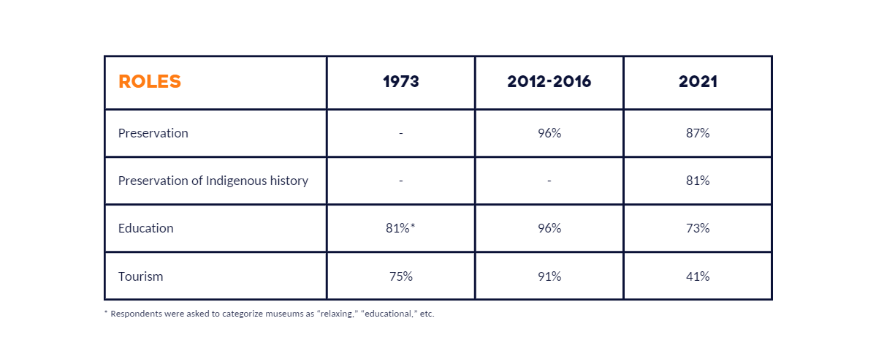
Notes:
Today museums are not just places for tourists. Education, but not necessarily learning, as a primary role is declining slightly in importance since 1973, while the preservation of Indigenous knowledge and collections is increasingly a more important role for the museum.

Slide 10
Notes:
Canadians still consider museums to be trusted sources and good places for children. However, there was a decrease in the percentage of Canadians who found museums to reflect their culture and heritage today, likely due to Canada’s increasingly growing and diverse population.

Slide 11
THE FUTURE OF MUSEUMS: WHERE ARE WE GOING?
By 2036, immigrants and second-generation individuals will represent between 40% and 50% of the population
By 2036, people of colour will be about one-third of the population
By 2036, almost three-quarters (71%) of people of colour will likely reside in Toronto, Montréal, or Vancouver
By 2041, the Indigenous population will be 2.5 to 3.2 million, at an average annual growth rate between 1.3% and 2.3%
By 2050, roughly 25% of the population will be over the age of 65
Notes:
Where are museums going? Canada is becoming more diverse. How Canadians think about the past and understand heritage is changing, particularly regarding Indigenous histories and cultures. How will museums reflect the heritage of Canada’s increasingly diverse population? How will museums embody reconciliation with Indigenous peoples?​ In response to Call to Action #67, our partners at the Canadian Museums Association have released Moved to Action, a report to support museums in acting on truth and reconciliation.
By 2050, roughly 25% of the population will be over the age of 65. Museum attendance tends to decrease with age, often due to disability issues. How will museums ensure improved accessibility for the growing number of Canadians over 65?​
Frequency of museum visiting increases with level of education, and the majority of younger Canadians have post-secondary education. How will museums ensure that content is credible and appealing to this audience?​
Canadians are also confronting significant global changes in climate and the environment, and they want museums to provide unbiased and credible content and context around these issues. How do museums plan to address the climate crisis both through education and their own climate actions?
Although Canadians continue to trust and value museums, and see them as community institutions, there is an uncertainty that museums can continue to sustain this trust and value in the face of these future challenges.
The data and resources created by Reconsidering Museums can help museums respond to our changing world and support museums to take action toward making the necessary changes Canadians want to see in their museums.

Slide 12
ACCESS
Do museums make you feel welcome and provide for your needs?
“Inclusive, complex, and nuanced narratives about the diverse peoples in my community.”
-Survey Respondent
Notes:
The research through Museums for Me​ revealed three main themes – Access, Authority, and Activism.
Access is about removing barriers and can refer to different types of accessibility including physical, financial, cultural, and intellectual accessibility. Accessibility in museums means that source communities have access to collections, and that information and knowledge is shared in a way that is understandable, relevant, and engaging. It means that the museum is inclusive, and a place where people see themselves reflected in exhibits, collections, and programs.
Canadian museums are doing this well but have room to grow. Canadians know about and visit museums, feel welcome in them, and recognize them as safe spaces. But nearly all want museums to be more inclusive and representative of their communities.
Highlights from the data
94% of respondents agree that museums make them feel welcome and provide what they need for their visits
88% of respondents agree that the museum is a safe place
76% of respondents agree that museums give people a sense of belonging and membership in a community
52% of respondents agree that museums need to better represent all Canadians.

Slide 13
AUTHORITY
“Museums are invested with authority and have a responsibility to deconstruct the harmful narratives they were responsible for upholding and reinforcing.”
-Survey Respondent
Notes:
Authority is about the perception that museums are trusted to provide accurate and credible information. Canadians continue to trust museums and to consider them a credible source of information. They value museums for their role in preservation and learning. To maintain this role, respondents indicated that the museum must reimagine its relationship to the truth, and as ‘trusted advisor’ to the publics it serves. Canadians want museums to continue to tell the truth, but to also embrace more diverse types of expertise, including community knowledge and lived experience.
Highlights from the data
95% of respondents agree that the museum is a place to preserve and care for art and objects, and to tell their stories
95% of respondents agree that the museum is a place to learn and be inspired
80% of respondents agree that museums are a highly credible source of information, above daily newspapers and television
58% of respondents agree that museums should have dialogue with local communities to develop programs that resonate with community interests

Slide 14
ACTIVISM
“Smash the patriarchy. Dismantle systemic racism. Unlearn white supremacy.”
-Survey Respondent
“More dialogue is needed - museums are a comfortable neutral space for that.”
-Survey Respondent
Notes:
Activism is about the role of museums as change-makers, allies, and leaders in a changing society. Canadians are divided on the question of neutrality, but not on the need for museums to take a leading role on important issues. The museum has value as a teacher, ally, and an agent of change. Canadians see the potential of the museum as a possible leader, and a model, poised to act, but doubt that the sector will rise to the challenge.
Highlights from the data
94% of respondents think that the museum can address societal issues
65% of respondents agree that museums should play a prominent role in education when it comes to addressing societal issues
44% of respondents agree that museums should play a more active role in advocating for social change

Slide 15
Notes:
Based on the research findings and with the future of museums in mind, the consortium developed a new value proposition, Collecting Perspectives, for museums to help reframe their role and value in contemporary Canada.
We value museums because they make sense of the world around us. They collect our tangible and intangible heritage and invite us to share in the many stories they help tell. Their collections broaden, inspire, and facilitate a shift in our thinking, but the most important work of museums is in collecting perspectives: in showing us how our stories are told.

Slide 16
OUR MUSEUMS: COLLECTING PERSPECTIVES
We value museums because they make sense of the world around us. They collect our tangible and intangible heritage and invite us to share in the many stories they help tell. Their collections broaden, inspire, and facilitate a shift in our thinking, but the most important work of museums is in collecting perspectives: in showing us how our stories are told.
“The walls of the museum should be porous - allow ideas to flow in and out. When a community views the museum as 'their' place then you have made progress.”
-Survey Respondent
“[Museums] can take me beyond my own experience of life and help me understand other perspectives.”
-Survey Respondent
Notes:
The development of this new value proposition was driven by data collected during Museums for Me.
Highlights from the data to support Collecting Perspectives:
95% of respondents agree that the museum is a place to preserve and care for art and objects, and to tell their stories
93% of respondents agree that museums spark curiosity, provoke wonder, and promote creativity, and a ‘love of learning’
93% of respondents agree that museums help them understand other cultures and communities
88% of respondents agree that museums give us information and perspective on important cultural and social issues

Slide 17
MUSEUMS COLLECT PERSPECTIVES to…
Museums are more than collectors of art and objects; they collect perspectives in order to collaborate with their communities, learn from each other, amplify diverse voices, communicate a message, advocate towards justice in their communities, activate their visitors to take action, and ultimately inspire change.
Notes:
Museums are more than collectors of art and objects; they collect perspectives in order to collaborate with their communities, learn from each other, amplify diverse voices, communicate a message, advocate towards justice in their communities, activate their visitors to take action, and ultimately inspire change.
Museums collect perspectives to…

Slide 18
COLLABORATE
Museums need their community.
“Museums need to be more responsive to their local communities, as well as to their place in the national and international milieus. Museums are not mirrors - they are culpable in the interpretation and engagement of community knowledge. Museums need to use their agency toward community partnerships and co-creative projects.”
-Survey Respondent
Notes:
Museums need their community. Community access, engagement, and collaboration are foundational for responsible museum work. As the production, distribution, and control of information continues to shift, museums are no longer the sole holder of knowledge. By collaborating with and empowering communities, museums show that they value collective expertise rather than attempting to maintain ownership of our shared cultural narratives.
76% agree that museums give people a sense of belonging and membership in a community

Slide 19
LEARN
Museums are learners too.
“I want a museum to open itself up to scrutiny and examine the role it plays in society.”
-Survey Respondent
Notes:
Museums are learners too. Museums encourage lifelong learning for their visitors and themselves. Through an openness to growing, adapting, and revising, museums acknowledge multiple ways of knowing and build a reciprocal relationship with their community. Our stories are always evolving, and our understanding and interpretation of those stories must evolve as well.
87% agree that museums advance knowledge as research institutions

Slide 20
AMPLIFY
Museums provide a platform.
“Museums need to confront their complacency in colonialism and change their practices to create space for minorities to feel safe, seen, and heard […] Bring the Indigenous experience to the front - historic and contemporary. Bring in the voices of LGBTQ+ to the front. Bring the youth in, bring the homeless in, bring [the] group that is missing in to tell their stories and share their perspectives […] It would start conversations that need to happen in a safe and trusted space.”
-Survey Respondent
Notes:
Museums provide a platform. As trusted public institutions, museums are in a position to amplify the voices of their community. By giving voice to and centering diverse community perspectives, museums can see themselves as conduits of ideas rather than the source. Representation of the community leads to increased community relevance.
93% agree that museums help them understand other cultures and communities

Slide 21
COMMUNICATE
Museums have something to say.
“Museums provide a place to use history to look at what is happening now, and to experience these truths (or to notice absences) in an environment that actually wants to hear everyone's thoughts and perspectives and create discussion around them.”
-Survey Respondent
Notes:
Museums have something to say. Canadians trust museums to tell the truth about our shared history. Museums are a place for dialogic learning where ideas are communicated openly with the goal of creating dialogue that leads to empathy and mutual understanding. Museums can be civic spaces for productive and respectful discourse at a time when seemingly irreconcilable points of view dominate our daily lives.
80% agree that museums are a highly credible source of information, above daily newspapers and television

Slide 22
Advocate
Museums take a stand.
“If local museums were less risk averse in their exhibitions, and more willing to tackle so-called controversial topics, they would feel more relevant.”
-Survey Respondent
Notes:
Museums take a stand. Museums can be credible advocates for causes that are aligned with their values. By supporting mission-centric causes, museums can live out their values and effect meaningful social change in their communities.
94% think museums can address societal issues

Slide 23
activate
Museums encourage participation.
“Museums need to be more pluralistic spaces that embody the dynamic tensions that we experience in our real, everyday lives.”
-Survey Respondent
Notes:
Museums encourage participation. Museums are active and playful spaces, where visitor interaction and creativity are encouraged. Visitors should be encouraged to engage with perspectives at the museum, and be inspired to contribute their own. A museum is also a school for the senses, where visitors can connect with their tactile, sensory, and emotional sides. Museums can surprise, delight, and astonish visitors by the many meanings, connections, and sensations they provoke.
93% agree that museums spark curiosity, provoke wonder, and promote creativity and a ‘love of learning’

Slide 24
inspire
Museums inspire change.
“I see museums as spaces in which I can learn and transform my own understanding of the world around me […] I am more likely to visit a museum if I feel there is something that may inspire me to positively change the way I engage with my community.
-Survey Respondent
Notes:
Museums inspire change. A visit to a museum should change the way you see the world around you.
95% agree that the museum is a place to learn and be inspired

Slide 25
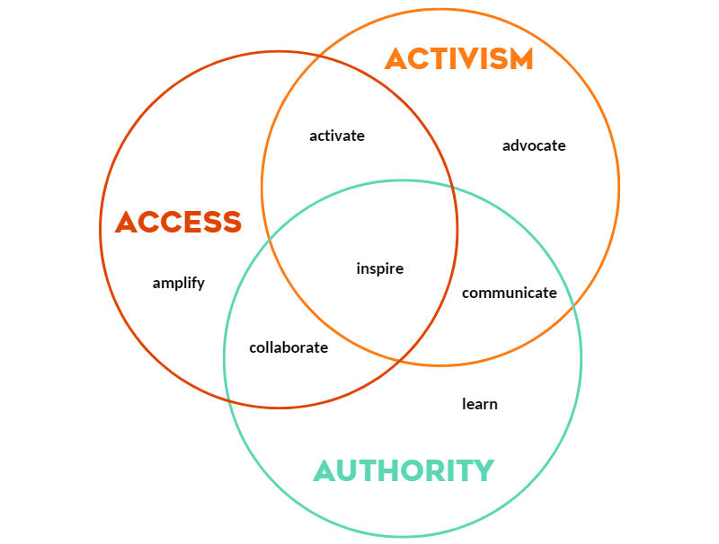
Notes:
These actions are interconnected with the themes of Access, Activism, and Authority.

Slide 26
Notes:
To build on the imperative for museums to rethink access, authority, and activism, the Truth Be Bold campaign was also developed.
Whose truth?
Museums have long asserted themselves as the authority, the experts, the holders of truth. But historically, they have often told half-truths, singular narratives, or misinterpretations entirely. Museums can do better.
The truth is that there is more than one truth. By collecting and sharing multiple, parallel, and divergent perspectives, museums have an opportunity to tell a fuller truth about our shared history. A truth that is not singular but contains multitudes.

Slide 27
TRUTH BE BOLD
Museums have long asserted themselves as the authority, the experts, the holders of truth. But historically, they have often told half-truths, singular narratives, or misinterpretations entirely. Museums can do better. The truth is that there is more than one truth. By collecting and sharing multiple, parallel, and divergent perspectives, museums have an opportunity to tell a fuller truth about our shared history. A truth that is not singular but contains multitudes.
“Present the truth above all else; the full picture, 'warts and all', not just the sunnier side of our history.”
-Survey Respondent
“When done right, museums can be one of the few places that still hold community trust.”
-Survey Respondent
Notes:
Truth Be Bold is a public campaign to highlight the important work of museums as both authority and advocate.
The development of this campaign was driven by data collected during Museums for Me.
Highlights from the data to support Truth Be Bold:
80% of respondents agree that museums are a credible source of information
95% of respondents think that the museum is a place to learn and be inspired
94% of respondents think that museums can address societal issues like climate change, reconciliation, and technological innovation
52% of respondents agree that museums need to better represent all Canadians
This campaign serves as a call to action for museums, as well as a marketing campaign to encourage the public to think differently about the role of museums, particularly in an age of mistrust and disinformation.

Slide 28
TOOLKIT
Notes:
These two public campaigns, Collecting Perspectives and Truth Be Bold, are just two of the many resources available in the Reconsidering Museums toolkit.
This toolkit is designed to make it easy for you to incorporate the data collected and messaging developed by Reconsidering Museums into your work. All types of museum workers, volunteers, and supporters will find this toolkit useful. The intention is for you to use the resources to articulate the value of museums more effectively and to respond to changing public expectations around the role of museums. Consistency is key, and that comes when like-minded people start to speak the same language about the importance of museum work.

Slide 29
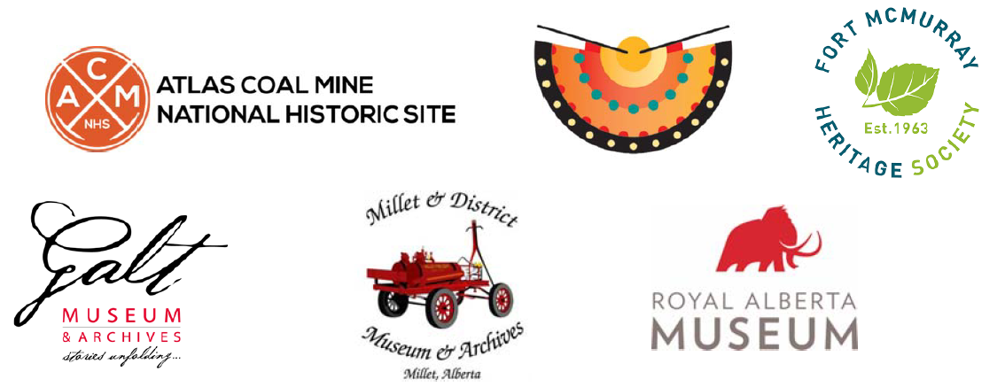
PILOT SITES
Notes:
The resources in this toolkit were piloted by six museums in Alberta with diverse mandates, budgets, audiences, and governance structures to ensure that the toolkit is adaptable and useful for a variety of sites. The pilot sites were Atlas Coal Mine National Historic Site, Blackfoot Crossing Historical Park, Fort McMurray Heritage Village and Shipyard, Galt Museums and Archives, Millet and District Museum, and the Royal Alberta Museum.

Slide 30
INFORMATIONAL TOOLS
What We Heard
Trust and Value
Fact Sheets
Notes:
There are three types of resources in the toolkit: informational, communications, and advocacy. Informational tools will provide you with an overview of the data that was collected through the engagement campaign, Museums for Me.
What We Heard Report: This report provides an in-depth analysis of what was heard through the Museums for Me engagement campaign including methodology, themes, and two appendices with the survey and public opinion polling data. Read this if you want to get more in depth on the data.
Trust and Value Report: This report provides a comparative analysis of a 1973 study on Canadians’ perceptions of museums with the data collected in 2021 as part of Museums for Me. Read this if you want to learn how Canadians’ perceptions of museums have changed or stayed the same.
Fact Sheets: These fact sheets provide specific data points and quotes from survey respondents in relation to the changing functions of museums. Use these data points to strengthen how you speak about the role and value of museums.
You've already had a brief overview of some of the data available in informational tools in this presentation.

Slide 31
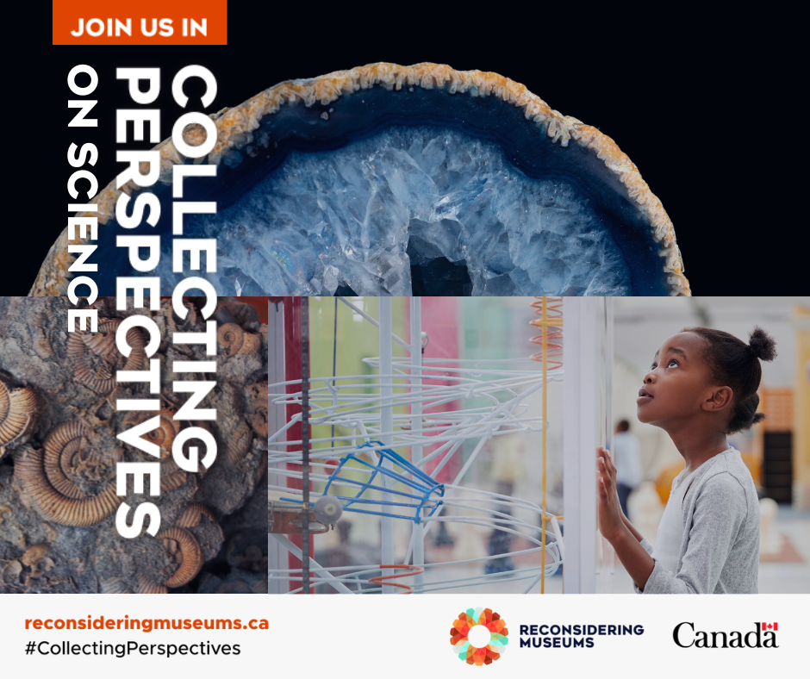
COMMUNICATION TOOLS
Collecting Perspectives
Truth Be Bold
Language Recommendations
Data Stories
Notes:
Communications tools will help you adopt and share the evidence-backed language recommendations and messaging developed in response to the research.
Collecting Perspectives Communications Package: This package includes the Collecting Perspectives graphics and messaging, as well as a how-to guide for creating a social media post using the free-to-use online graphic design tool Canva. Use this package to create your own Collecting Perspectives social media campaign.
Truth Be Bold Communications Package: This package includes the Truth Be Bold graphics and messaging, as well as a how-to guide for posting on social media. Use this package to create your own Truth Be Bold social media campaign.
Language Recommendations: This resource includes evidence-backed recommendations for how to speak about the changing role and value of museums, while avoiding some of the outdated language around museums. Read these recommendations to learn how to reframe the conversation about museums.
Data Stories: The data stories transform the data from Museums for Me into specific, useable, and focused data insights on the work and value of museums. Read these data stories to understand how Canadians’ perceptions of museums are shifting, and to gain insight on visitation.
You’ve already seen Collecting Perspectives and Truth Be Bold, so let’s briefly explore the language recommendations and data stories.

Slide 32
LANGUAGE RECOMMENDATIONS
1. From Elitist to Relevant
2. From Authority to Collaboration
3. From Neutrality to Credible Advocacy
Notes:
There are three language recommendations that are designed to facilitate a more productive conversation around the role and value of museums. There is one recommendation for each of the themes of access, authority, and activism. The recommendations came out of the desire to create a shared language around the value of museums, while acknowledging that certain words, like neutral and elitist, that have been associated with museums, do not always have a shared meaning. Neutrality means something different to museum workers than it does to the public.
The three recommendations are From Elitist to Relevant, From Authority to Collaboration, and From Neutrality to Credible Advocacy that can help to reframe the conversation. Here are the reframes:
From Elitist to Relevant
The majority of Canadians report feeling welcome and safe in museums, however, many do not feel as though the museum represents them. The idea that museums are ‘not for them’ persists as many people do not see themselves, and their interests, communities, and histories, represented in the museum’s collections, exhibits, and programming. The disconnect is because the museums are not presenting stories that are relevant to their lived experience, not because people find museums elitist. People would visit museums more if museums told stories that are relevant to them and their communities.
From Authority to Collaboration
Authority is held by everyone. Museums share authority with communities by collaborating to produce and disseminate knowledge. Multiple types of knowledge, including oral traditions and experiential knowledge, are valued and included. The relationship between museums and their communities is relational, not transactional. Through those relationships, the museum can move from seeing themselves as the expert to embracing the role of learner. By doing this, museums earn the trust of their communities through reciprocity and knowledge sharing, not solely expertise. Visitors are seen as community members that actively participate with the museum to co-create their own learning experience.
From Neutrality to Credible Advocacy
Museums are trusted institutions that can combat disinformation and encourage critical thinking by presenting the facts, sharing multiple perspectives, and creating space for dialogue. Museums should acknowledge their biases and encourage visitors to reflect on their own. Museums have a role in addressing societal issues like reconciliation, the climate crisis, and inequity. Younger Canadians in particular, want museums to take a more active role in advocating for social issues, because they are accountable to their communities.

Slide 33
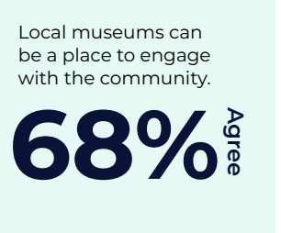
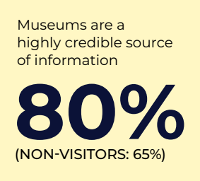
DATA Stories
1. Who is Visiting Canada’s Museums?: Demographics and Visitation
2. Exploring Financial Accessibility: Cost as a Potential Barrier to Visitation
3. Getting to Relevance Through Accessibility and Representation
4. Telling the Truth: Trustworthiness, Learning, and Sharing Authority
5. Social Change, Activism, and Neutrality
Notes:
There are five data stories that can help you make sense of the data from Museums for Me. Two relate to demographics and barriers to visitation. The other three are connected to the themes of Access, Authority, and Activism.
Getting to Relevance Through Accessibility and Representation
Museums strive to remove barriers to visitation by creating accessible, safe, and welcoming environments for all visitors. Identifying the barriers that remain and removing those barriers can increase participation of occasional and non-visitors.
Telling the Truth: Trustworthiness, Learning, and Sharing Authority
At a time when confidence in public institutions is becoming increasingly tenuous, museums continue to hold the trust of Canadians. Research affirms that the public continues to value museums as trustworthy sources of information. Even people who identify as non-visitors trust museums.
Social Change, Activism, and Neutrality
The museum sector is currently grappling with the shifting role of museums as active advocates for social change. Some museums are taking steps to address social issues relevant to their communities in their exhibits, collections, and programs. Some museums are hesitant to embrace the role of advocates for social change out of concern over public expectations for museums to remain neutral.

Slide 34
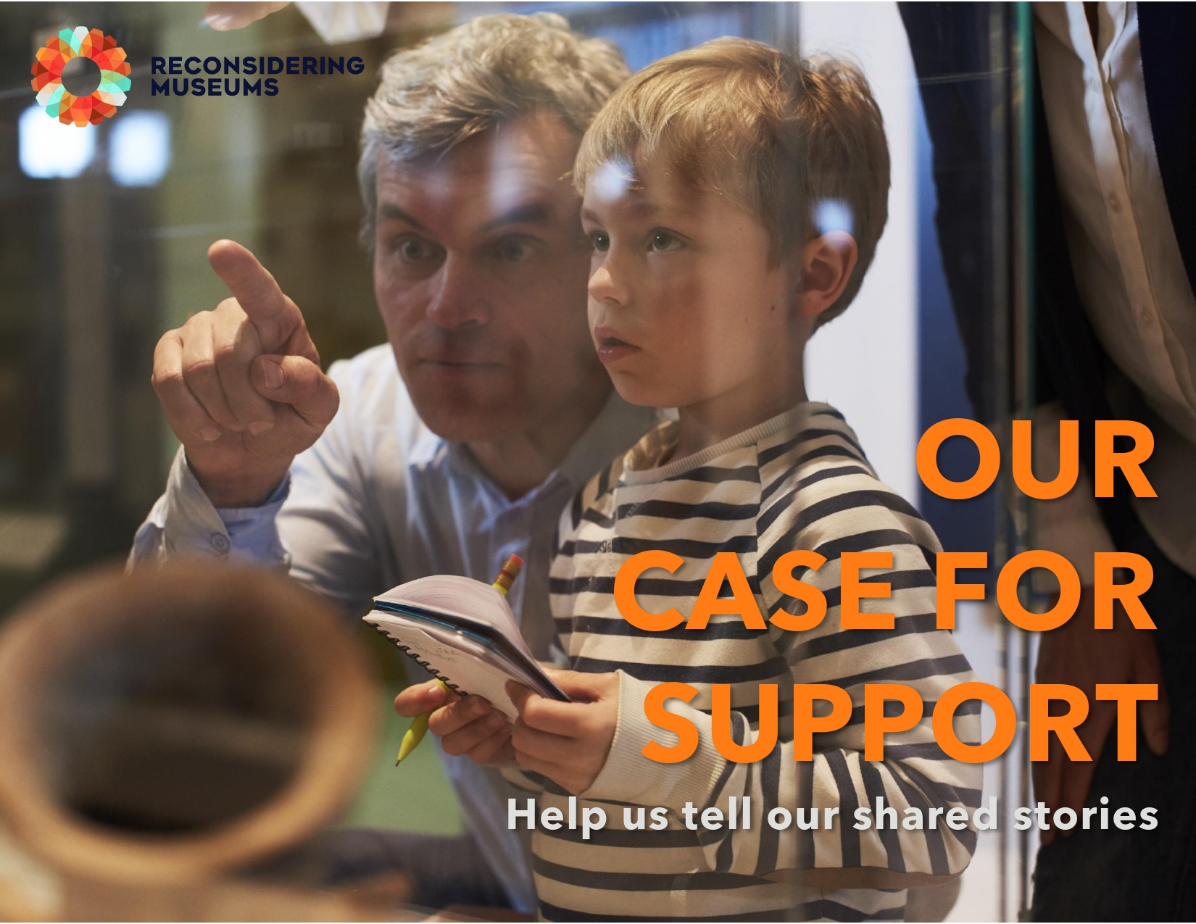
ADVOCACY TOOLS
Case for Support
Letter Templates
Advocacy Policy Template and Action Guide
Notes:
Advocacy tools will support you in advocating for your museum, the sector, and for community issues outside your museum.
Case for Support and Explainer: The case for support is an adaptable fundraising document that includes an explainer to help you customize the case, as well as an example of a finished case. Use this template to create a values-based fundraising document for your own museum.
Letter Templates: Letter templates targeting all three levels of government, as well as a community support letter template, are included. Use these templates to create a letter writing campaign for your own museum.
Advocacy Policy and Action Guide: This guide includes an advocacy policy template for both internal and external advocacy, as well as a step-by-step action guide for doing the work of advocacy. Use this guide to create an Advocacy Policy for your own museum.
Let’s explore the Advocacy Policy and Action Guide in more detail.

Slide 35
Notes:
This resources was created in response to the need for museums to take a more active role in advocating for societal issues. Remember that 44% of respondents think museums need to be taking a more active role in advocacy, but that number rises to 62% for ages 18 to 34. This resource is important for the future of museums.
Highlights from the data:
94% of respondents agree that museums can address societal issues
93% of respondents agree that museums help them understand other cultures and communities
88% of respondents agree that museums give us information and perspective on important cultural and social issues

Slide 36
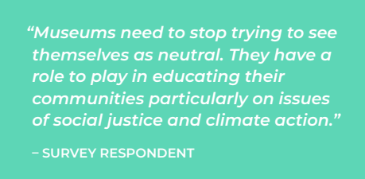
ADVOCACY POLICY TEMPLATE & ACTION GUIDE
Five Cs of Advocacy
1. Considerations
2. Consciousness
3. Courage
4. Conversation & Collaboration
5. Clarity
Notes:
What is advocacy?
Advocacy relates to how a museum is actively working to advance a particular cause or issue to change opinion, policy, or practice. Within Reconsidering Museums, advocacy is defined broadly as advocacy can take on many different forms depending on a museum’s circumstance or place in its community. Every museum will advocate differently and work on various social and environmental issues, including but not limited to climate change, Indigenous issues and reconciliation, 2SLGBTQIA+ issues, local community issues, etc. In addition to advocating for social change, a museum may also wish to advocate for internal or industry-wide relations such as financial support, staff and Board support, etc.
There are a number of foundational considerations for an organization, its Board, and staff to step in to the work of advocacy. The Five Cs are phases that are important and essential in order for museums to be successful with their advocacy work. Learn more about the Five Cs in the guide.
Purpose of the Advocacy Policy Template and Action Guide
The purpose of the Action Guide is to help museums self-identify where they are at in their advocacy journey and to provide insights and examples on how they may go about conducting advocacy and developing an Advocacy Policy to make real and lasting change. It is time for museums to speak up and out on issues that support their mission and their communities—to take a stance on these issues and not remain neutral, especially in times of immediate support.
What is an Advocacy Policy?
An Advocacy Policy is a policy, approved by the museum’s Board of Directors in a motion, that outlines the causes, ideas, and issues that are important to the museum. More importantly, it delineates how the museum as a whole will react to moral or civic challenges that arise in your communities. The policy acts as a reference to ensure that roles within the museum’s team are clearly defined when it comes to advocacy efforts.
Developing an Advocacy Policy will ensure that your museum Board, staff, and volunteers are all on the same page about how you conduct advocacy efforts internally and externally.

Slide 37
Notes:
Reconsidering Museums provides resources for museums to do work of being responsive and adaptive, but this project is not an end to itself. While the data collected through Museums for Me provides valuable insights into the public perceptions of the role, value, and future of museums, museums must continue to connect with, listen to, and respond to their own communities. The resources in the Reconsidering Museums toolkit are not one-size-fits-all. They are designed to be adaptable and customizable to your own specific museum and context. The work of reconsidering the role and value of museums is ongoing.

Slide 38
Notes:
The consortium gratefully acknowledges the financial support of the Government of Canada through the Canada Cultural Investment Fund and the Province of Alberta through the Community Initiatives Program for the Reconsidering Museums project.

Slide 39
THANK YOU!
reconsideringmuseums.ca
info@reconsideringmuseums.ca

